Slide 1
Natural Language Processing
Introduction

Slide 2
Contents
Introduction to Natural Language Processing
Terminology
NLP Pipelines

Slide 3
Contents
Introduction to Natural Language Processing
Terminology
NLP Pipelines

Slide 4
Natural Language Processing
NLP is concerned with how computer programs process and analyse natural language data.
Example NLP Tasks:
Spell Checking

Slide 5
Natural Language Processing
NLP is concerned with how computer programs process and analyse natural language data.
Example NLP Tasks:
Spell Checking
Finding synonyms

Slide 6

Natural Language Processing
NLP is concerned with how computer programs process and analyse natural language data.
Example NLP Tasks:
Spell Checking
Finding synonyms
AI like Alexa, Siri, OK Google

Slide 7

Natural Language Processing
NLP is concerned with how computer programs process and analyse natural language data.
Example NLP Tasks:
Spell Checking
Finding synonyms
AI like Alexa, Siri, OK Google
Keyword extraction and search
https://amueller.github.io/word_cloud/auto_examples/a_new_hope.html

Slide 8

Natural Language Processing
NLP is concerned with how computer programs process and analyse natural language data.
Example NLP Tasks:
Spell Checking
Finding synonyms
AI like Alexa, Siri, OK Google
Keyword extraction and search
Machine Translation
https://translate.google.com/

Slide 9
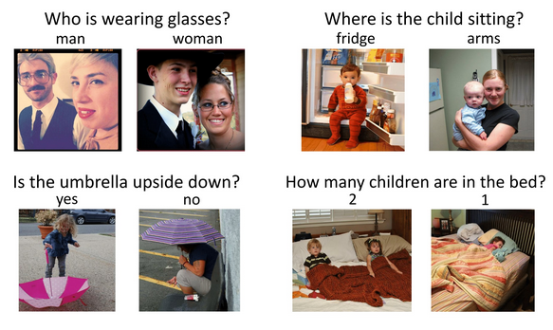
Natural Language Processing
NLP is concerned with how computer programs process and analyse natural language data.
Example NLP Tasks:
Spell Checking
Finding synonyms
AI like Alexa, Siri, OK Google
Keyword extraction and search
Machine Translation
Visual Question Answering
Making the V in VQA Matter: Elevating the Role of Image Understanding in Visual Question Answering (CVPR 2017)

Slide 10

Natural Language Processing
NLP is concerned with how computer programs process and analyse natural language data.
Example NLP Tasks:
Spell Checking
Finding synonyms
AI like Alexa, Siri, OK Google
Keyword extraction and search
Machine Translation
Visual Question Answering
Generating images from text cues
https://www.craiyon.com/

Slide 11

Natural Language Processing
NLP is concerned with how computer programs process and analyse natural language data.
Example NLP Tasks:
Spell Checking
Finding synonyms
AI like Alexa, Siri, OK Google
Keyword extraction and search
Machine Translation
Visual Question Answering
Generating images from text cues
Spam classification

Slide 12
What makes NLP tricky for computers?
Context
Computers often fail to understand the context of a sentence. This ability generally comes naturally to humans.

Slide 13
What makes NLP tricky for computers?
Context
Computers often fail to understand the context of a sentence. This ability generally comes naturally to humans.
Consider the following example:
The television didn't fit through the corridor because it was too wide.
The television didn't fit through the corridor because it was too narrow.

Slide 14
What makes NLP tricky for computers?
Context
Computers often fail to understand the context of a sentence. This ability generally comes naturally to humans.
Consider the following example:
The television didn't fit through the corridor because it was too wide.
The television didn't fit through the corridor because it was too narrow.
A fantastic movie for those who are looking forward to being bored.
A fantastic movie for those who are bored and forward looking.

Slide 15
What makes NLP tricky for computers?
Structure
NLP is difficult because it lacks a precisely defined structure. We can contrast this with structured languages such as:
Python, SQL
HTML, XML, JSON
Mathematics
Structured languages are easily understood by computers because they are defined by a strict sets of rules and grammar. Syntax errors occur when a computer cannot precisely interpret the grammar or structure of the language.

Slide 16
Contents
Introduction to Natural Language Processing
Terminology
NLP Pipelines

Slide 17
NLP Terminology
In NLP, we often hear people refer to terms, documents and corpuses.

Slide 18
NLP Terminology
In NLP, we often hear people refer to terms, documents and corpuses.
Term | A word in a document
Document | A sequence of words
Corpus | A collection of documents

Slide 19
NLP Terminology
Some examples of Documents and Corpuses
Document | Corpus
One book | A collection of books
One tweet | A dataset of tweets
A web article | A collection of articles

Slide 20
Contents
Introduction to Natural Language Processing
Terminology
NLP Pipelines

Slide 21
NLP Pipelines
The basic NLP pipeline consists of three main stages.
Text
pre-processing
Feature
Extraction
Modelling
Note: Stages can be added or omitted depending on the task. Depending on the application, not all steps of the NLP pipeline will need to be performed.

Slide 22
NLP Pipelines – Text pre-processing
Text
pre-processing
Feature
Extraction
Modelling
We often need to convert our raw data into a form that is ready for feature extraction. For example:
If your document is html, we may want to remove tags, hyperlinks and keep only the relevant text
We may want to convert every word into lowercase to make sure that they are all treated in the same way in subsequent steps

Slide 23
NLP Pipelines – Text pre-processing
Text
pre-processing
Feature
Extraction
Modelling
Example of text pre-processing
<p>Yer a wizard, Harry!</p>
Yer a wizard, Harry!
yer a wizard harry

Slide 24
NLP Pipelines – Feature Extraction
Text
pre-processing
Feature
Extraction
Modelling
Once we have the cleaned text, we will need to extract features and decide how we are going to represent each element in our dataset. One way to extract features is to do a word count.

Slide 25
NLP Pipelines – Feature Extraction
Text
pre-processing
Feature
Extraction
Modelling
Feature extraction for NLP
Bag of Words
TF-IDF
Embedding approaches (Word2Vec, OpenAI API etc.)

Slide 26
NLP Pipelines – Modelling
Text
pre-processing
Feature
Extraction
Modelling
Once we have extracted the relevant features, we can feed these features into a machine learning algorithm to perform predictive analysis or we can even directly visualise the features using different data visualisation techniques.

Slide 27
Contents
Introduction to Natural Language Processing
Terminology
NLP Pipelines

